Slide 1
Studying and Building Innovation Clusters: an Economic Growth Dimension
International Scientific Conference
“The Triple Helix and Innovation-Based Economic Growth: New Frontiers and Solutions”
Tomsk September 11-13, 2014
Nataliya Smorodinskaya,
Daniil Katukov
Institute of Economics,
Russian Academy of Sciences
PS 14
“Dimensions of Studying and Building Innovation Clusters:
European Lessons”

Slide 2
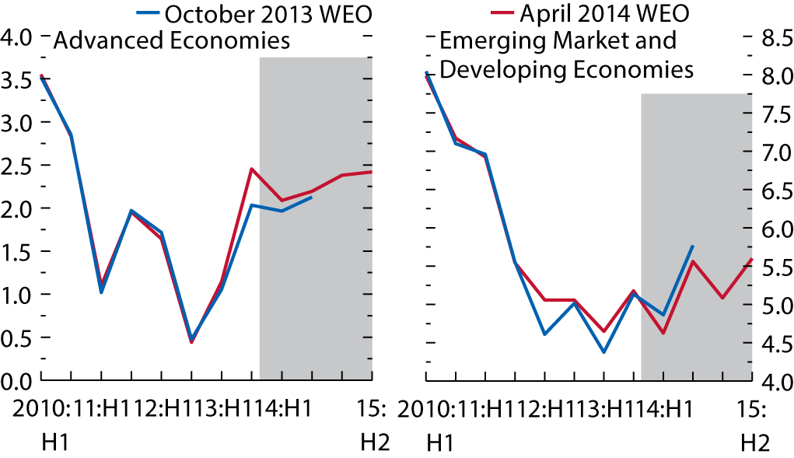
‘New normal’ in growth
2014 (IMF forecast): global GDP - 3.6% , developed - 2.3%, developing - 5.3%
Since 2H 2013 global activity strengthened , but the pickup was uneven: advanced economies steadily recovering, emerging markets slowing or running uneven, esp. BRICs
Divergence in dynamics between developed and developing worlds
(GDP, annualized semiannual percent change)
GDP in 2014, %
EU – 1.6, US – 1.7
China – 7.4
Brazil – 1.3
India – 5.4
Sources: IMF, WEO Apr 2014
Quality of growth has started to shape the balance between nations in terms of their economic dynamics and sustainability

Slide 3
Global crisis of 2007-2009 has pushed economies towards a new organizational pattern based on clusters and other innovation ecosystems meant to produce innovations in the XXI century
producer innovation (Schumpeter 1934)
user-driven innovation
(von Hippel 1985)
strategic innovation
(Hamel & Prahalad 1994)
open innovation (Chesbrough 2003)
collaborative innovation networks (Gloor 2005)
Evolution of innovation models
Source: Russell, 2011
‘Eco’ stands for highlighting non-linear nature of innovation and the key role of collaboration (horizontal interactive networking) to generate it.

Slide 4
To master innovation-led growth economies are embarking on a new, cluster-oriented model of industrial policy, a functional synthesis of its two historical predecessors
Types of Modernization | Catching-Up Industrialization | Transition to a market economy | Post-industrial transition
Model and goal of industrial policy | Classic, or vertical (critical mass of strong industries) | Neo-liberal, or horizontal (critical mass of strong market institutions) | Systemic, or cluster-oriented (critical mass of strong clusters and innovation ecosystems)
Typical economies and best practice | Developing systems (Japan in 1950s, Korea in 1960s) | Transition systems (young EU-members) | Developed, developing and transition systems (Scandinavian nations)
Government’s status and functions | Supervisor and developer (sets priorities and shapes industrial structure ) | Supervisor on the free market (sets and supports institutional context) | Equal partner and interface-manager (facilitates networking, improves business environment)
Mode of government interventions | Vertical (selecting industries, and picking winners) | Horizontal (soft framework interventions across all sectors) | New horizontal measures with vertical projections (matching winners across and within clusters)
Pattern of business environment | Mostly hierarchic ties | Mix of vertical and horizontal ties | Mostly horizontal ties and network collaboration
Authors’ elaboration based on: Rodrik 2008, Warwick 2013, WEF 2013

Slide 5
Modern cluster literature, stemming from Porter’s ideas (Delgado, Stern, Ketels, Lindqvist, Sölvell, others), treats regional clusters as ecosystems able to generate continual innovation (‘competitiveness upgrading’), thus making a difference with other kinds of agglomerations and networks
HARVARD BUSINESS SCHOOL
Two definitions of clusters:
descriptive (classical): “a geographically proximate group of interconnected companies, suppliers, service providers and associated institutions in a particular field linked by externalities of various types” [Porter 2003, p.562].
conceptual: a holistic model of relationship between geographical proximity and industrial competitiveness, which generates localized externalities through coexistence of competition and collaboration [Porter 1990, Porter 1998, Ketels 2013]
Michael Porter

Slide 6
Regional innovation clusters (RICs) are sophisticated and super-dynamic systems that may be described in three dimensions:
A special class of agglomerations (groups of co-located and related companies) that serve as new building blocks of today’s industrial structure and as specialized regional (localized) nodes of GVCs that run across the world
A special class of networks which function as TH-based innovation ecosystems and generate unique synergy effects of continual innovation
A special class of economic projects (cluster initiatives) based on ‘relationship’ contracts and led by a TH-type cluster organization
Authors’ generalization of cluster literature :
Sölvell 2009, Porter & Ketels 2009, etc

Slide 7
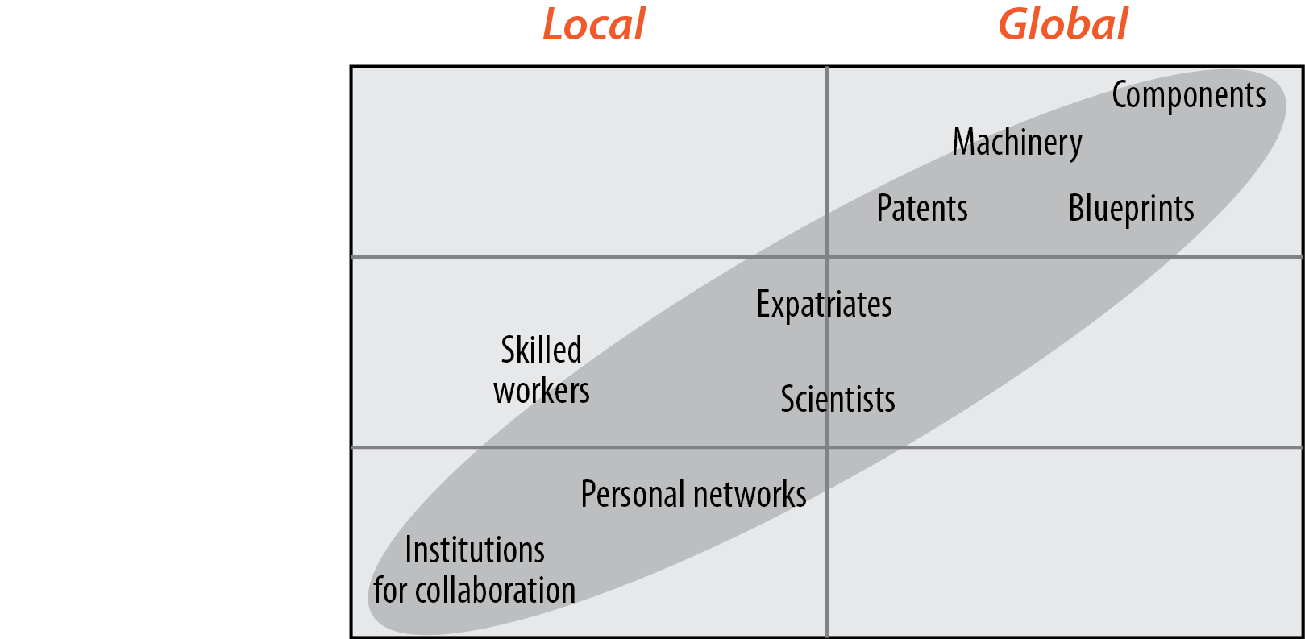
The dynamism of modern RICs as production systems
If and when becoming a specialized node of GVC, clusters enjoy a mobile combination of local and global resource flows (‘glocality’)
I – global mobility
II – mixed mobility
III – local business environment
This lets cluster participants to upgrade their resources in a mutually reinforcing manner, which continually enhances their dynamics and productivity
Source: Solvell, Lindqvist, Ketels 2003, Malmberg 2003

Slide 8
RIC as a specific ecosystem among various kinds of networks
Adapted from: Anderson et al. The Cluster Policies Whitebook, 2004
collaborative partners of various profile form ‘cluster ecosystem’ (TCI, 2013).
self-governance through institutions for collaboration (cluster managers) under cluster project
collaboration of Triple Helix actors forms critical mass for innovative synergy effects

Slide 9
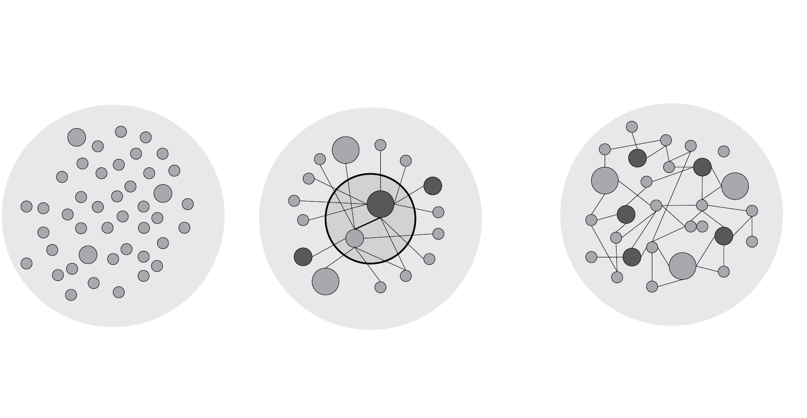
Not all networks treated as clusters in national cluster programs are real RICs that can generate innovation synergy
Three patterns of cluster-like networks in world practice
Authors’ generalization: OECD, 2007, 2009; VINNOVA, 2010; DASTI, 2011; Porter & Ketels, 2009; Ganne & Lecler, 2009

Slide 10
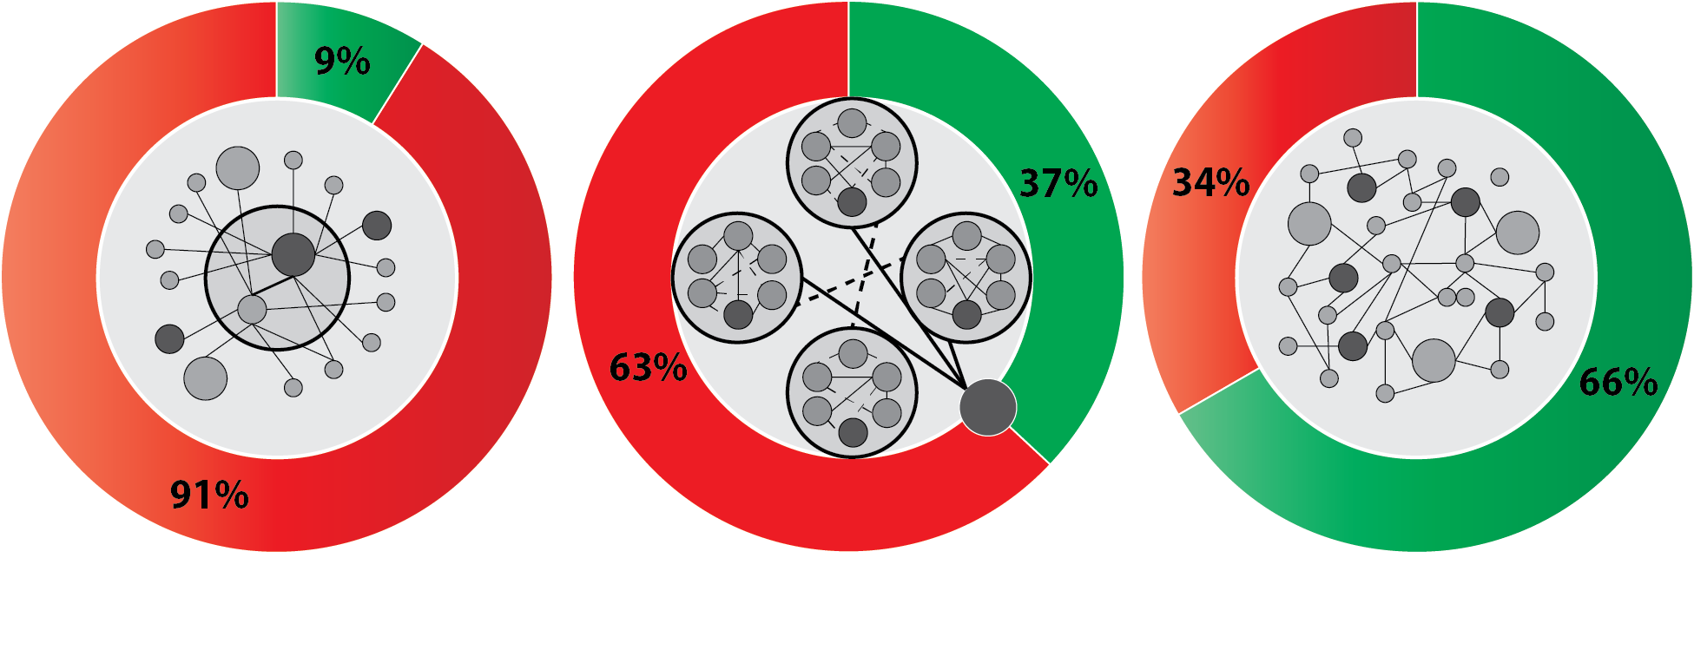
Three types of clusters in Germany (since 1995, cluster programs since 2003)
Government funds (federal or federal lands)
Private investments
Based on: Meier zu Köcker , 2009
1 Focal models (around a key actor). Grow in breadth but without network externalities, fully depend on budget funds
2 State governed networks of several cluster groups. Lack of dynamism, conflict of interests, high dependence on budget funds
3 Regional innovation clusters . High dynamism, THM, self-sustained growth , increasing reliance on private investments

Slide 11
As a special class of projects, clusters are open-end TH-type initiatives
participants are networked via a membership in a cluster organization
project is realized by a combination of cluster governance (a team representing TH-actors) with cluster management (several professionals)
Management tasks are very specific: a continual removal of communication gaps to bridge stakeholders for collaborative innovation
According to European Cluster Observatory (Greenbook 2.0, 2013):
about 1085 cluster projects have been launched worldwide (mostly in OECD members)
356 projects in 50 countries have been studied (incl. 254 projects within EU)

Slide 12
How can an industrial agglomeration transform itself into a RIC?
Implementation of Hessenmetall cluster initiative (Germany)
Space dimension:
networks emerge from local to global, clusters – locally
Interactions: networks
rely on cooperation, clusters - on ‘coopetition’
Overlapping space:
when co-located actors
start networking, they pool together agglomeration effects with collaboration externalities, which leads to innovation synergy
Based on: Sydow 2006, Bode 2011
But to become a sustainable RIC the group needs a TH-based cluster governance and good cluster management (Andersson et al. 2004, Solvell 2009)

Slide 13
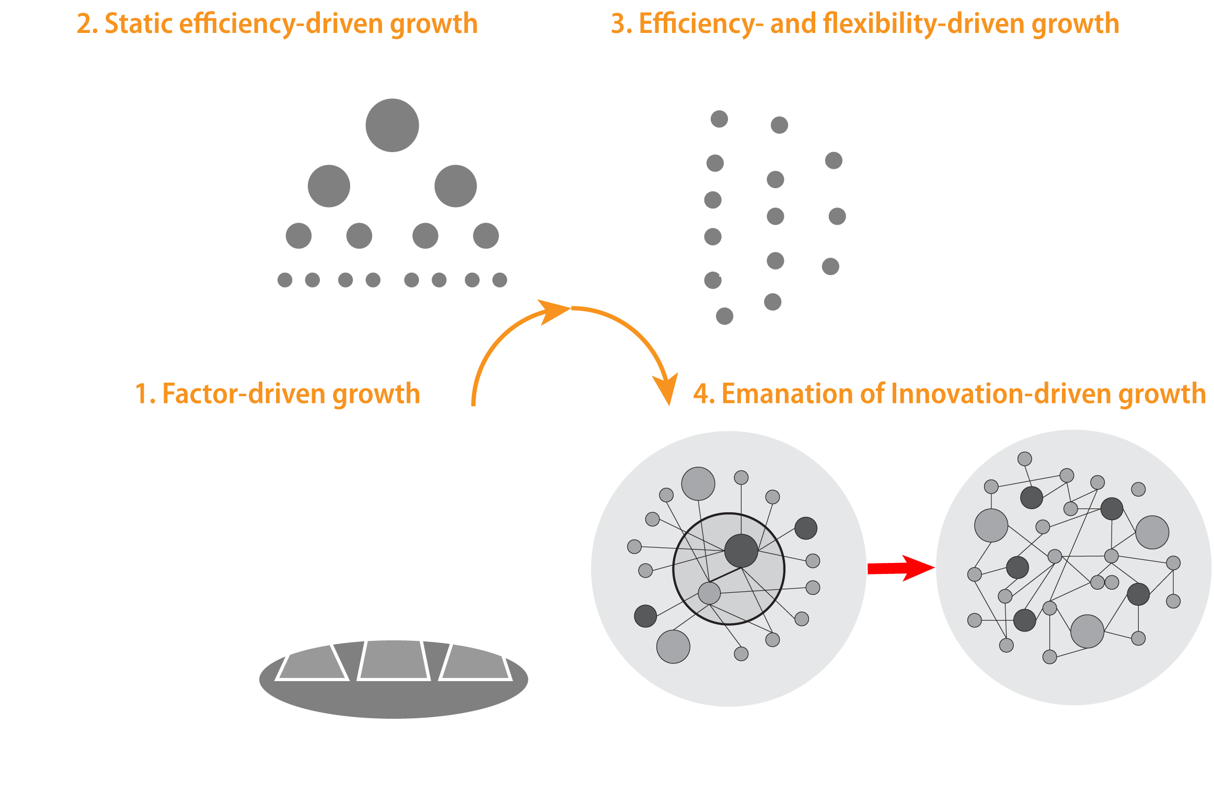
From industrial complexes to RICs :
sophistication of production and growth models

Slide 14
Economic externalities: from ‘Third Italy’ to RICs
Effects of co-location
Polycentric networks
of local SMEs
(mainly horizontal links)
‘Third Italy’
Concentric circles of SMEs around key actor
(mostly hierarchic links)
“Industrial clusters’
Regional innovation
clusters
(horizontal links streamlined through a vertical project-led discipline )
scale, social proximity, sporadic innovation
Agglomeration + limited network effects
scale, scope, linear innovation
Agglomeration + network effects + collaboration synergy
scale, scope, interactive innovation (competitiveness upgrading)
Governments should promote TH-collaboration in RICs to reinforce their network externalities , and in this way, to leverage aggregate gains in competitiveness, rather than cultivate agglomerations as such (Greenbook 2.0, Ketels 2012, Nallari & Griffith 2013)

Slide 15
From industry-based to cluster-based economic systems
Evolution of agglomerations
mid-late 2000s
Emanation of network order
mid 1990s-early 2000s
Globalization (CVCs)
mid 1980s- early 1990s
Internalization of markets
Transnational inter-cluster ecosystems (Oresund, Star Dust, ScanBalt Bioregion)
Regional innovation clusters (TH-based)
1970-s-early 1980s
Mature markets
Porter’s industrial clusters (focal networks of large firms & SMEs)
Innovation synergy effects of economy-wide scale
Beccatini’s industrial districts (networks of local SMEs)
Large industrial corporations
Traditional markets
Based on: Ganne & Lecler 2009, Porter & Ketels 2009, Eriksson 2010
Only upon assuming a cluster-based structure and TH-matrix economies can obtain sustainability under any global rapids and uncertainties

Slide 16
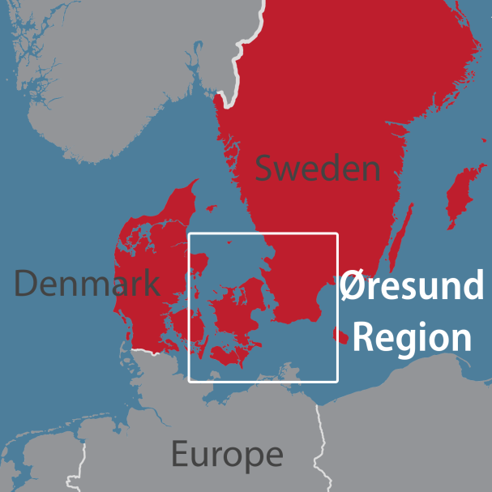
Øresund Region is a striking example of transnational innovation ecosystem
Under a common cluster umbrella project Danish and Swedish border regions are developing a unique form of inter-cluster collaboration called ‘double triple helix’
Cluster 55 (founded by Lund University in 1999) is one of the strongest European clusters.
60% of networking and collaboration cases are now self-developed and don’t need any more facilitation from the cluster management
Sources: www.cluster55.org; Hansen & Serin,2010 , Meier zu Köcker 2010, Karlsson et al. 2010

Slide 17
Sweden and other Nordic nations are global front-runners in imbedding the cluster idea and TH-matrix in micro- and macroeconomic policies
The EU Strategy for the Baltic Sea Region (2009)
follows Scandinavian growth model in line with Porter’s ideas and the new industrial policy approaches:
to support growth through continual improvement of business environment, enabling inter-organizational networking and clustering, i.e. to apply horizontal institutional measures instead of vertical monetary and fiscal stimulators
by cultivating TH-links to move from certain clusters to a program-led clusterization of economy at all levels and in all sectors (industrial, financial, administrative)
Sources: Christensen, Thomsen & Lomholt 2011, Ketels 2012
Outcomes :
50 strong transnational clusters across the Region
GCI-2013: BSR – 20th place (Sweden - 6, Estonia - 32, Russia - 64)
GII-2014: Sweden -3nd place, Finland – 4th , Denmark -8

Slide 18
At the EU-wide level, the cluster approach is integrated both into Cohesion Policy & Integrated Industrial Policy
Cohesion Policy 2014-2020 (with S3 as stipulation for funding) | Integrated Industrial Policy (as ‘Europe 2020’ flagship initiative)
Smart Specialization Strategies (S3): To move regions at designing their specific development strategies built on existing strengths To integrate the cluster idea into regional strategies To push regions to more innovative activities through TH-based cluster projects To mobilize resources at different levels when implementing regional strategies Cluster approach: Strong conceptual basis for realizing S3 Cluster initiatives are tools to examine regional strengths and TH-stakeholders’ engagement Funding: € 351.8 bn, or 32.5% of EU 2014-2020 budget | Mix of policies (competition, infrastructure, manufacturing, sectors’ level) To create an attractive business environment by removing barriers (as key objective ) To stimulate investment in Advanced Manufacturing and Key Enabling Technologies To strengthen European value chains and create a single European market Cluster approach: Clusters are tools to create regional innovation ecosystems and integrate SMEs into GVCs Basis to integrate industrial policy goals into S3 (EU Commission’s proposal, 2014) Funding: € 80 bn Horizon 2020 + € 100 bn ESIF + money from other programs & EU funds
Sources: European Commission 2010, 2012, 2013, 2014; Ketels 2013; Ranga 2013

Slide 19
Some conclusions
1. Real clusters are not about saving those who are ‘too big to fail’, but about more competition and TH-partnerships to achieve innovation synergy. European experience shows that a cluster’s success is affected both by its own ecosystem features (way of its formation, organizational model, type of governance or funding) and by a proper business environment (as according to Porter’s Diamond)
2. To support horizontal linkages and the emergence of cluster initiatives is becoming a new macroeconomic must for all types of economies, especially for catching- up systems. Through successful clusters the economies can steadily lift to higher VA stages of GVCs and thus reinforce their growth potential
3. Russia lacks proper institutional and business environment to create true innovation clusters. Some regional innovation enclaves (like Tomsk) do launch certain successful manufacture projects, but rather thanks to their intellectual capital than to their special status of a RIC.

Slide 20
katukoff@gmail.com

